Slide 1
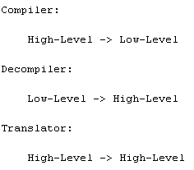
Translation

Slide 2
AST
Build by using tokens (identifiers, methods, reserved symbols)
Abstract structure of source code (what is in source code, but not how is written)
Skip details of real syntax (grouping parentheses, comma and etc.)
Program
Statement
Expression
Statement
Statement
assign
Expression
variable name
y
if (x < y) x = x - y; else y = y - x
Concrete AST is a tree according particular grammar

Slide 3
Recursive Descent
Top
Recursive Descent is top-down, left-right process (as deep-first search)
Verify the syntax of input stream
Provides a character a head (know what to expect from input stream)
Node A
Left
Right
Node B
Node E
Left
Left
Right
Right
Node C
Node D
null
Node F
Left
null
Left
Right
Right
Right
null
null
null
null
null
Down
Stack (LIFO)
F
E
D
C
B
A
Right
Left

Slide 4



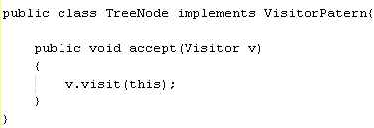
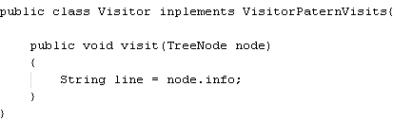
Visitor Pattern
Each tree node has method with parameter of visitor instance
Visitor node has methods with parameters of tree instances
AST
Notes:
Two interfaces for visit() methods another for accept() methods, tree nodes should have accept() method, in visitor class it is implement visit() methods

Slide 5
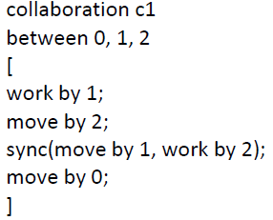

Encoder
Converts information from one format to another
BoCoLa
Java
Java
Notes:
Converts information from one format to another (ACTUAL conversations)

Slide 6
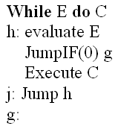
Backpatching
Fill jump instructions without knowing the jump target yet
Outputting a dummy target address and fixing it later
Notes:
Backward jumps causes no problems, because the jump instruction is generated after the instruction at the destination address, so !!destination address is known!!.
Forward jumps is difficult, because the jump instruction must be generated before the instruction at the !!destination address is NOT KNOWN!!

Slide 7
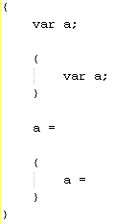
Non Local Variables
Variables which are accessible in every scope
Can be modified anywhere
Create mutual dependencies (two blocks, uses one variable)
Use as control mechanism (flags)
Non Local Variable
Local Variable
Notes:
Depends on the scope, local variables is in local scope, global variables could be accessed from everywhere

